Slide 1
VEHICLE PARKING MANAGEMENT SYSTEM

Slide 2
ABSTRACT
As our parking system is quite improper, we selected this project in order to improve this system, to avoid all manual errors and to save time for the people.
Our project parking management system includes two types of users, new user and regular user. There will be unique features like parking cash deposit, less parking charges benefits for regular user.
This project consists of type of vehicle, slot availability, generating ticket, generating price, login, arrival and departure of the vehicle.

Slide 3
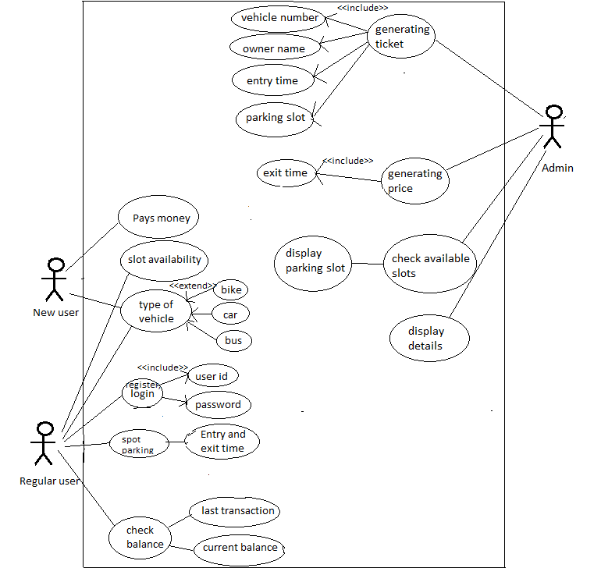
USE CASE DIAGRAM

Slide 4
TECHNOLOGY USED:
All computer software needs certain hardware components or other software resources to be present, in order for computers to be used efficiently. These prerequisites are known as System Requirements. Within this, we have two types – Software Requirements and Hardware Requirements.
SOFTWARE REQUIREMENTS
Software Requirements deal with defining the software resource requirements and prerequisites that need to be installed on a computer to provide optimal functioning of an application. These preconditions are generally not included in the software installation package and need to be installed separately.
In order to use CODIAC, one should have the following:
Operating System: Windows 7 and above
C Compiler: GNU Compiler Collection (GCC)
Editor: Vim editor .
HARDWARE REQUIREMENTS
Hardware requirements refer to the common set requirements defined by any operating system or software application and are usually the physical computer resources. In this, we look into the architecture, processing power, memory, secondary memory, display adapter and peripherals.
In order to use this project, one should have the following:
Processor: Intel Pentium processor and above
Memory: 4 GB RAM and above

Slide 5
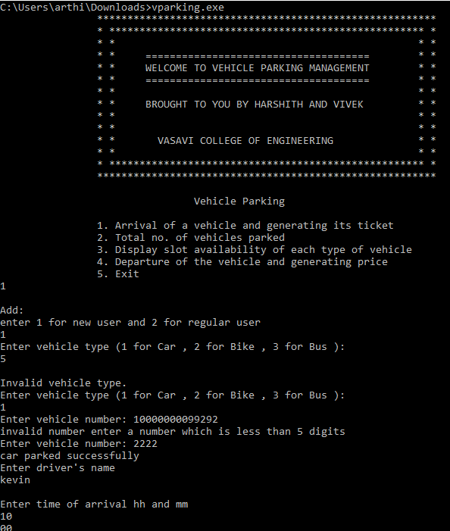
RESULTS:

Slide 6
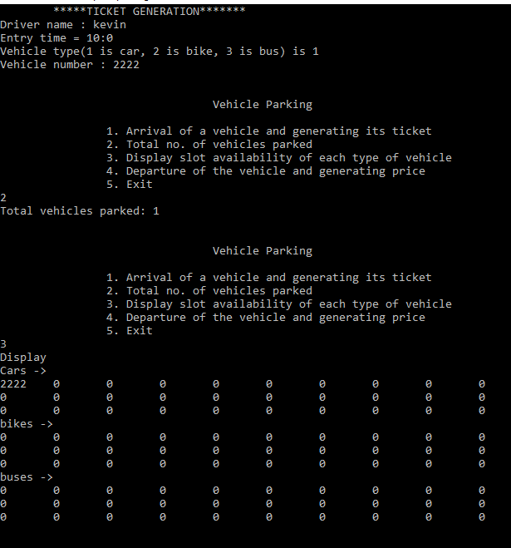

Slide 7
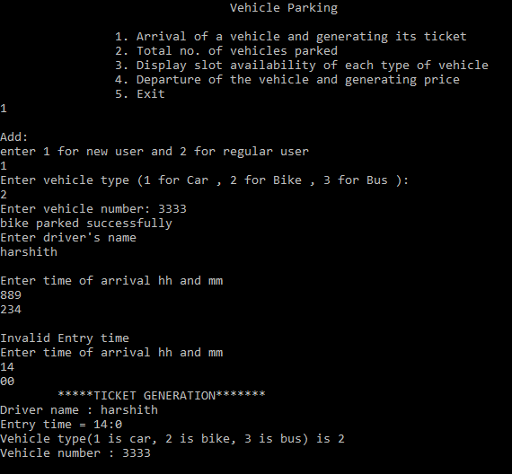

Slide 8
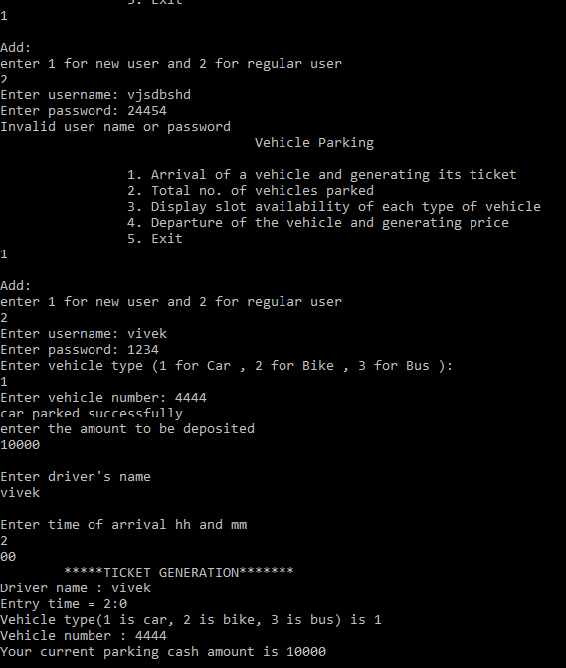

Slide 9
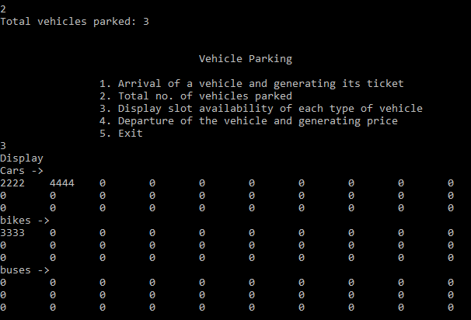

Slide 10
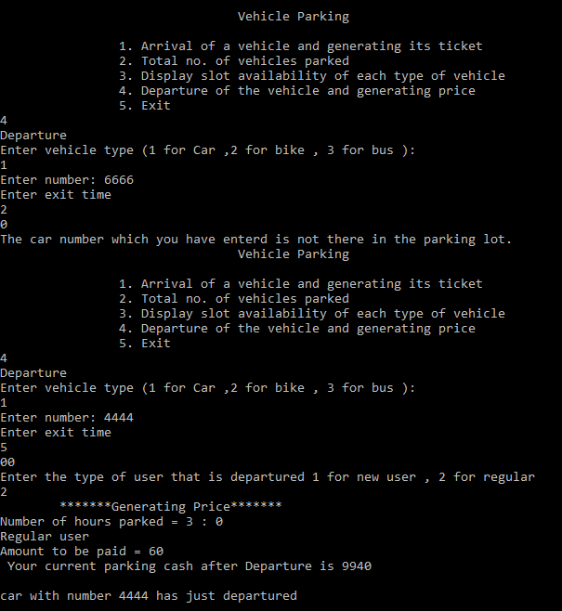

Slide 11
CONCLUSION AND FUTURE WORK:
We conclude that this application is useful for everyone to view number of covid cases in any country/continent across the world.
It can be operated very easily.
Future work is that we wanted to display even current cases at any place and make this console application as a web application.

